Slide 1
Regression Analysis
Lecturer: Dr. Bo Yuan
E-mail: yuanb@sz.tsinghua.edu.cn

Slide 2
Regression
To express the relationship between two or more variables by a mathematical formula.
  x: predictor (independent) variable
  y: response (dependent) variable
  Identify how y varies as a function of x.
  y is also considered as a random variable.
Real-Word Example:
  Footwear impressions are commonly observed at crime scenes. While there are numerous forensic properties that can be obtained from these impressions, one in particular is the shoe size. The detectives would like to be able to estimate the height of the impression maker from the shoe size.
  The relationship between shoe sizes and heights

Slide 3
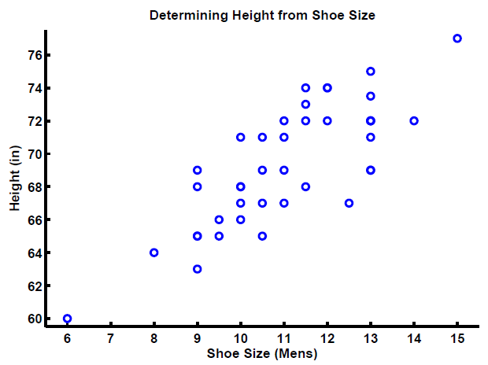
Shoe Size vs. Height

Slide 4
Shoe Size vs. Height
What is the predictor?
What is the response?
Can the height by accurately estimated from the shoe size?
If a shoe size is 11, what would you advise the police?
What if the size is 7 or 12.5?

Slide 5
General Regression Model
The systematic part m(x) is deterministic.
The error ε(x) is a random variable.
  Measurement Error
  Natural Variations
  Additive

Slide 6

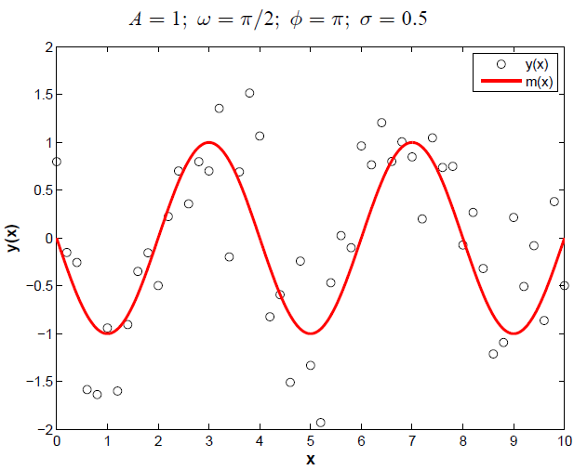
Example: Sine Function

Slide 7
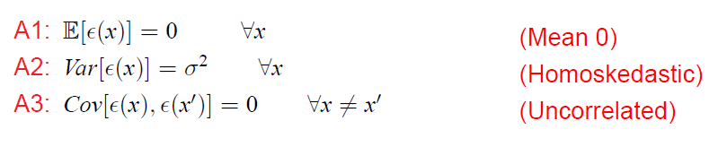
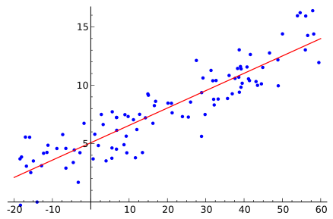
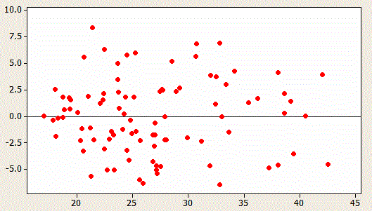
Standard Assumptions

Slide 8
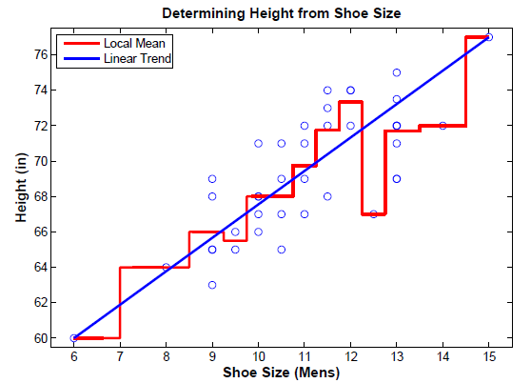
Back to Shoes

Slide 9
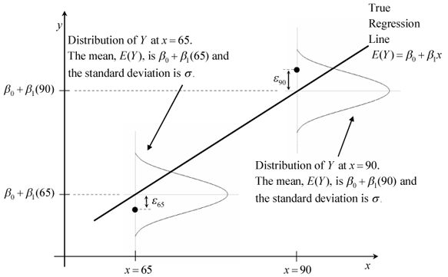
Simple Linear Regression

Slide 10
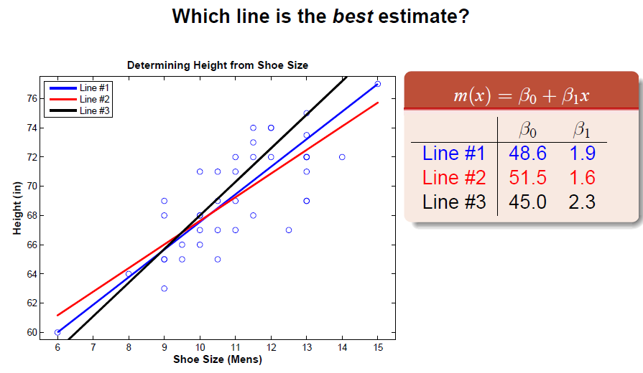
Model Parameters

Slide 11
Derivation

Slide 12
Standard Deviations

Slide 13
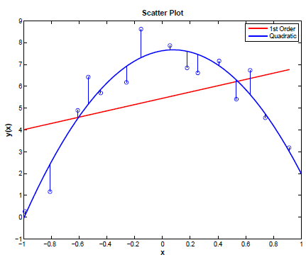
Polynomial Terms
Modeling the data as a line is not always adequate.
Polynomial Regression
This is still a linear model!
  m(x) is a linear combination of β.
Danger of Overfitting

Slide 14
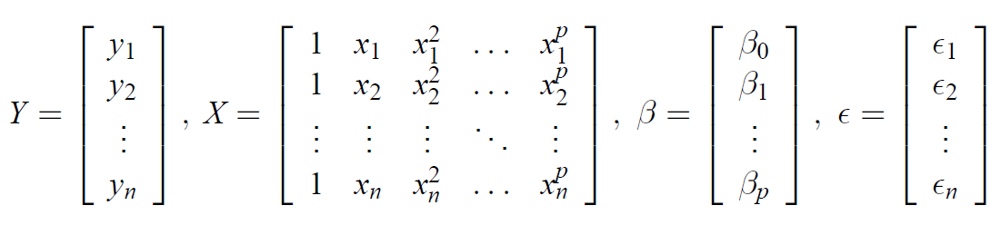
Matrix Representation

Slide 15
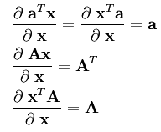

Matrix Representation

Slide 16
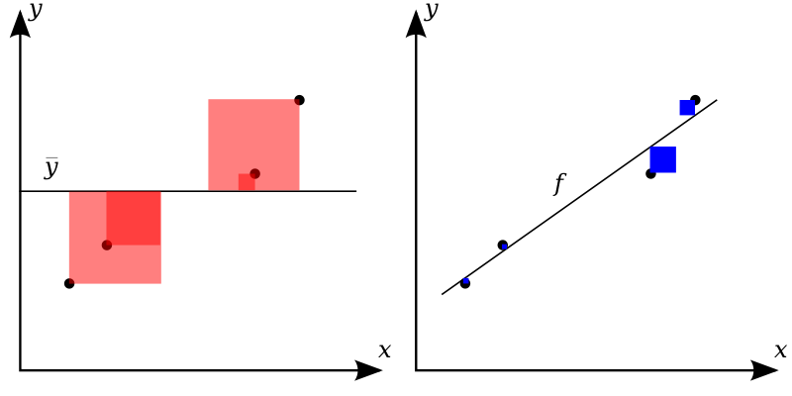
Model Comparison

Slide 17
R²

Slide 18
Example

Slide 19
Tricky Relationship
Youth
Elderly
Fitness
Exercise Time

Slide 20
Violent Crime vs. Video Game
Notes:
Video game sales: in billion US dollars
Crime in the United States by Volume and Rate per 100,000 Inhabitants
http://en.wikipedia.org/wiki/Crime_in_the_United_States
http://www.healthline.com/health-news/video-games-saints-or-psychopaths-082814
Does Media Violence Predict Societal Violence? It Depends on What You Look at and When
Christopher J. Ferguson
Journal of Communication doi:10.1111/jcom.12129

Slide 21
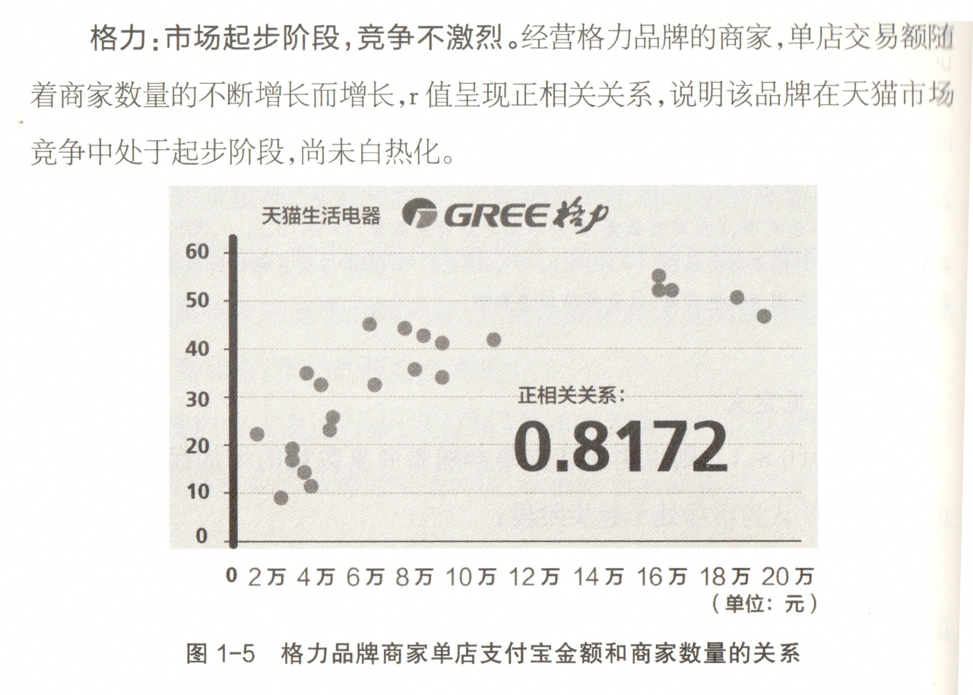

这是真的吗？
Notes:
《淘宝大数据》 p.30

Slide 22
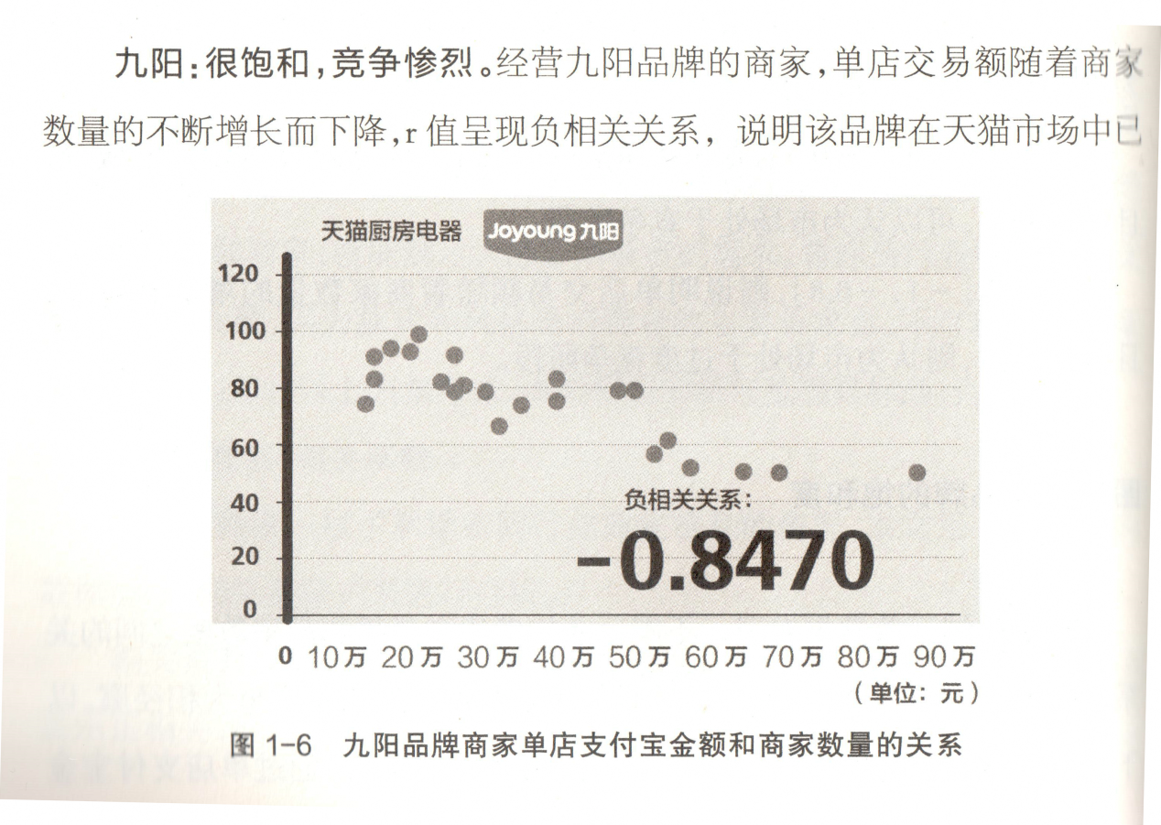

时间去哪儿了？

Slide 23
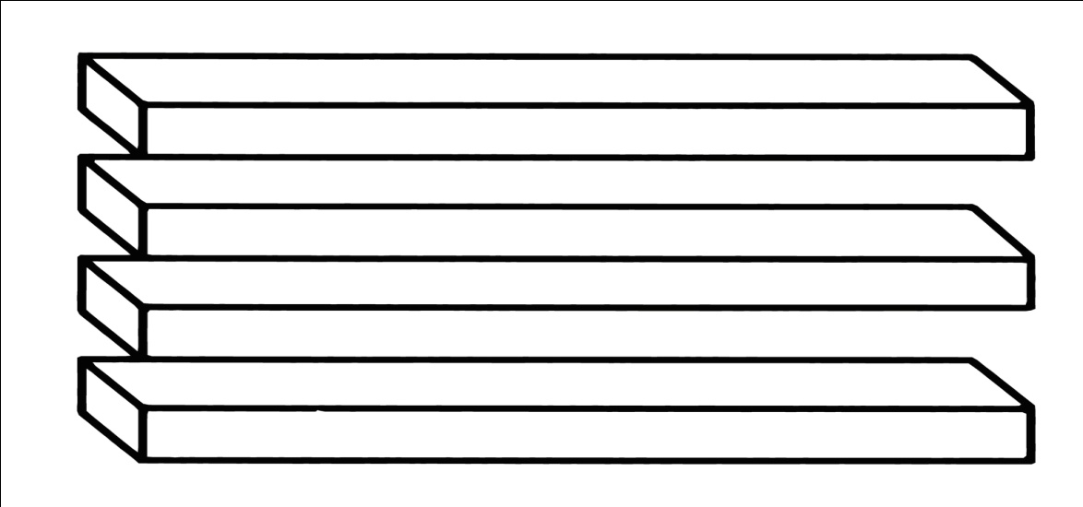
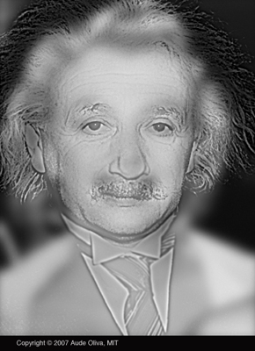
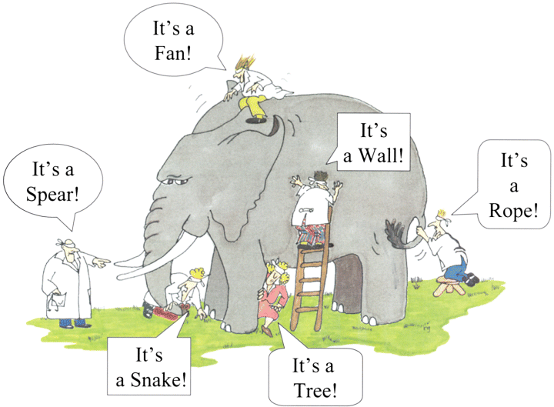

Slide 24
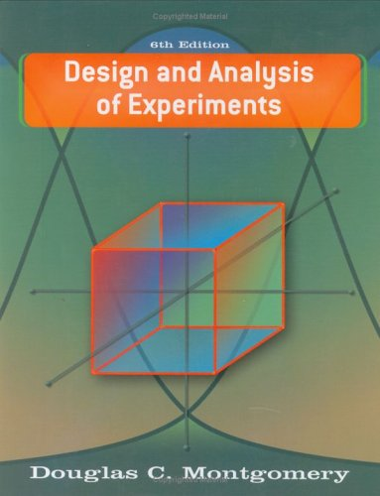
Summary
Regression is the oldest data mining technique.
  Probably the first thing that you want to try on a new data set.
No need to do programming!
  Matlab, Excel …
Quality of Regression
  R²
  Residual Plot
  Cross Validation
What you should learn after class:
  The Influence of Outliers
  Confidence Interval
  Nonlinear Regression

